Slide 1
Unified Salesforce Templates for RSA Support
Prepared by: Alie El-Deen Ibraheem
Nadeem Hisham

Slide 2
Outline

Slide 3
Outline
Objectives
Delivery Phases
Phase 1
Phase 2
Phase 3
Challenges

Slide 4
Objectives

Slide 5
Objectives
The target is to unify the support emails exchanged throughout communications with customers.
This will effectively enhance customers’ experience when opening a ticket with RSA Support.
It also establishes a unique fingerprint for RSA Support personnel by communicating with customers using a familiar, customer-oriented language recognized as RSA’s.
The work can be segmented into 3 phases:
Phase 1: Communication flow and stages – Introducing a flowchart for case handling.
Phase 2: Segmenting template types and drafting Communication Templates.
Phase 3: Enhance Communication Templates and Introduce drafts for Technical Templates

Slide 6
Phase 1
Communication Flow and Stages

Slide 7
Communication Flow
The flow can be segmented into 5 stages. Each of these conditions the necessary reply templates for the current standpoint in any support case.
Stage 1: Initial Reply – Earliest communication point after case creation.
Stage 2: Call/Meeting – Preparing for / Scheduling a meeting.
Stage 3: Investigation – Asking customers for further data or keeping them updated with the current investigative state.
Stage 4: Relief – Providing the necessary responses to customers for addressing their inquiries.
Stage 5: Follow-Ups – Follow up with customers on the delivered content.
Stage 6: Special Cases – Templates designed for special cases (discussed further in the following slides).

Slide 8
Communication Flow Chart
The diagrams in the following slides illustrate the different communication stages, along with the necessary responses for each of the respective endpoints of the chart.
The conditions (represented by rhombi) depict the next stage of the case depending on inputs from the previous/current standpoint.
The endpoints (represented by squares) depict an action to be taken, with each one translating to a specific template type (with several distinct styles that serve the same message).

Slide 9
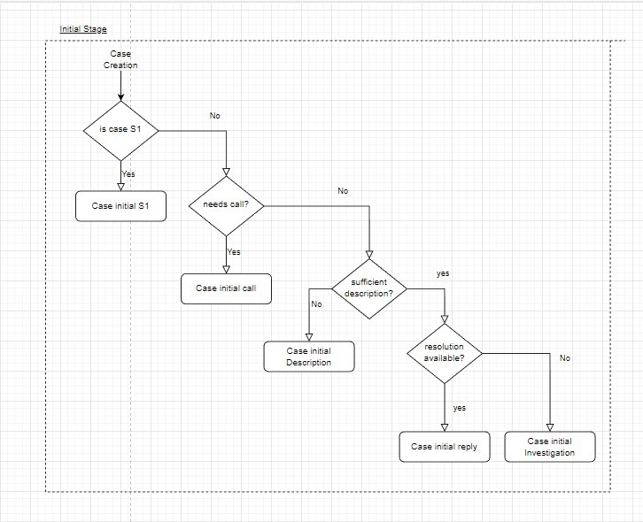
Stage 1

Slide 10
Stage 1 – Initial Response Templates
Case Initial S1 Response – Necessary response for an S1 case.
Case Initial Call Response – Initial response to engage in a Call/Meeting.
Case Initial Description – Initial response to asking customers for more information.
Case Initial Reply – Ready-to-use templates containing technical/informational data (Tech templates).
Case Initial Investigation – An Initial response signaling to customers that the support resource is investigating their requirements.

Slide 11
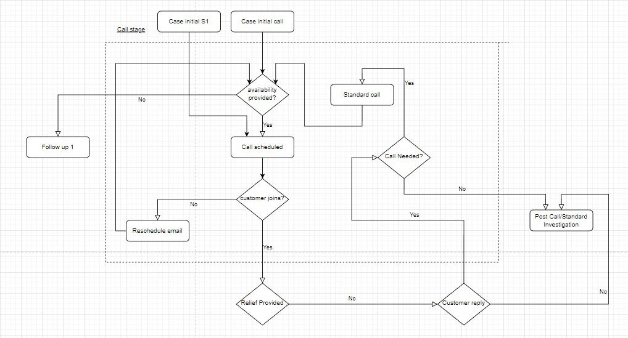
Stage 2

Slide 12
Stage 2 – Meeting Templates
Reschedule – To reschedule a meeting.
Standard Call – A standard reply issuing a request for a call with a customer for moving forward with the investigation.
Post Call/Standard Investigation – A template used for communicating the summary of a conducted meeting, while noting that further investigation is still needed from the support’s end.
Call Scheduling – Used for scheduling a meeting with a customer on a pre-communicated agreed timing.

Slide 13
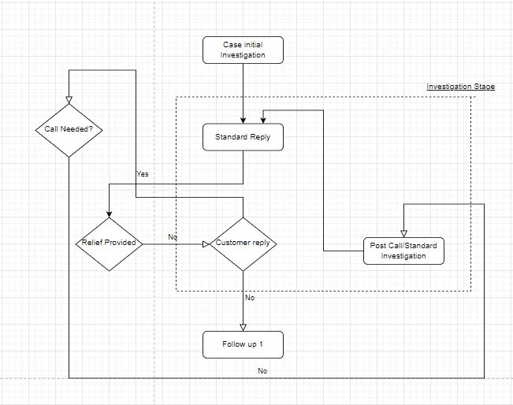
Stage 3

Slide 14
Stage 3 – Investigation Templates
Standard Reply – A customizable reply message that can be used to provide information/relief to customers or ask customers for further information based on the current standpoint.
Engineering Engaged – Informing customers that RSA Engineering/Development teams are currently investigating the issue.
Engineering Data – Asking customers to send over / engage in a meeting for collecting more data to pass on to Engineering.
Engineering Updates – Delivering updates from Engineering to customers upon investigating and possibly, solving the issue.

Slide 15
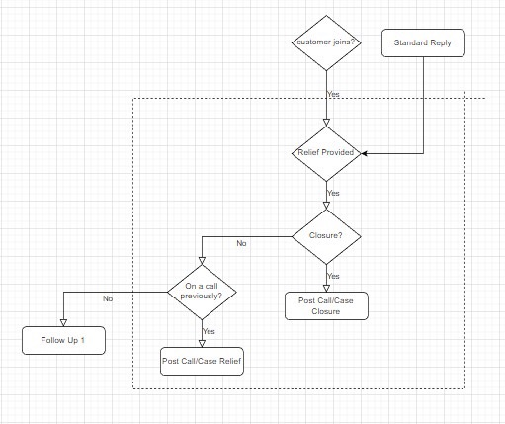
Stage 4

Slide 16
Stage 4 – Relief/Closure Templates
Post Call/Case Closure – A summary of the work performed on a solved case, delivered to customers right before proceeding with closure.
Post Call/Case Relief – A summary of the work performed on a solved case, which has been kept open upon customers’ requests (monitoring periods for example).

Slide 17
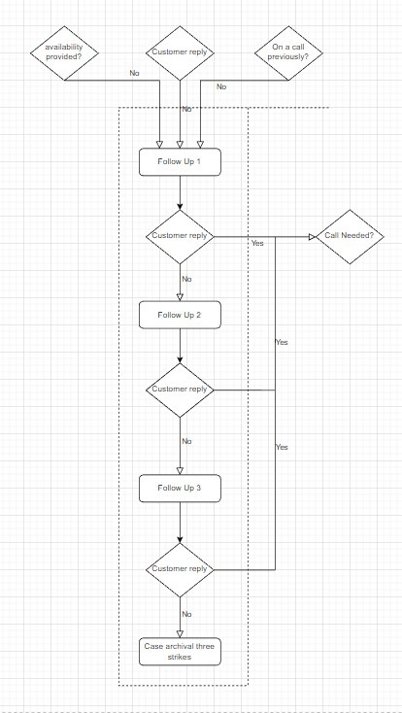
Stage 5

Slide 18
Stage 5 – Follow-Up Templates
Follow-Up 1 – First follow-up email sent to customers.
Follow-Up 2 – Second follow-up email sent to customers.
Follow-Up 3 – Third follow-up email sent to customers.
Case Archival/3-Strikes – An email signaling that for either a solved or an incomplete case, it will be archived for the time being since no replies have been received from customers.

Slide 19
All Flow Stages

Slide 20
Stage 6 – Special Cases Templates
EOPS – An email template that signifies that a specific piece of product the customer is enquiring about is out-of-support (legacy Authentication Manager versions – AM v8.1 for example).
Russia/Belarus – A template designed to inform customers in Russia and Belarus that their support requests will be declined, as of the current circumstances.
Unsupported Integrations – To inform customers that the Vendor Products they enquire about can not currently be integrated with RSA SecurID solutions.

Slide 21
Phase 2
Segmenting template types

Slide 22
Segmenting Templates
The templates to be used can be segmented into 2 types:
Technical Templates/Advisories: Ready-to-use technical, informational templates that can be delivered directly to customers to address their requirements (will be explored in Phase 3).
Communication Templates: Used for communicating and exchanging information with customers throughout a Support Case (outlined in Phase 1).

Slide 23
Technical Templates/Advisories – A Brief
These templates can be used to address repetitive/re-occurring issues/queries where one email can be used to supply the needed information to address customers’ needs.
They intend to deliver either recent updates/advisories officially announced by RSA or address re-occurring customer environment issues that can be tackled with the same approach each time.
Examples of such scenarios include:
Resetting Identity Router (IdR) Password
Updating Cloud-IdR Portal Certificate
Upgrading/Downgrading Authentication Manager Licenses
Authentication Manager migration process
Advisories for Security Vulnerabilities

Slide 24
Communication Templates – Challenges Ahead
These templates need to be articulated to sound professional, informational, and customer-friendly – to deliver optimum customer experience.
The challenge for such a task is to deliver the content in a non-monotonic manner as much as possible since these templates ought to be used by a huge number of support personnel.
The suggested approach is to draft each template with different sentence suggestions that deliver the same idea (explored further in the following slides).
This can allow support engineers a variety of options whilst communicating with customers at each stage of any given case.

Slide 25
Phase 3
Enhancing Communication Templates

Slide 26
Communication Templates – Challenges Ahead
The email messages are divided into several sections (denoted by numbers –> 1,2,…). Each section represents a part of the message in sequential order.
Example:
1. I wanted to touch base with you on the current status of the case.
2. Have you had a chance to look over the provided notes?
Each section carries multiple sentence suggestions (denoted by alphabetic characters -> A, B, …) that deliver the same message, offering a wider range of choices.
Example:
A) According to the case notes, you seem to be facing issues with _.
B) From the provided case description, I understand that _.
Within each sentence suggestion, options (denoted by square braces -> [ ]) are included for specifying a specific message to deliver to a customer.
Example:
Our [Engineering/Development/SaaS] would like to [collect the logs for _ / perform further tests on _ / acquire more details about _] to [further investigate the issue / perform conclusive analysis].

Slide 27
Example
Hello
I hope you are doing well.
1.
A) Please note that we have engaged our [Engineering/Development/SaaS] team on this issue. Undergoing investigations are now taking place for identifying and correcting the issue, and possibly, proposing a descriptive RCA for the incident.
B) Kindly note that we have raised a concern to the [Engineering/Development/SaaS] regarding the issue in question. We are currently at work on a solution and are actively looking for the root cause of the issue.
C) I have opened an internal ticket with our [Engineering/Development/SaaS] team for looking into this issue and am awaiting their further updates.
2.
A) Therefore, please allow us some time to get back to you with some results, and a proposition for a possible fix. I will be getting in touch with you as soon as we develop some progress in our investigation.
B) In the meantime, please be patient with us until we get to the bottom of this. I will keep you updated on the investigation state of the case.
C) I will provide further updates to you the soonest, soon as I receive any feedback from them.
Please let me know if this answers your questions. If you have any further inquiries, feel free to reply to this email.
Have a nice day!
Best Regards,
Nadeem Naoum | Technical Support Engineer | SecurID - RSA Security.
Customer Help Desk: EMEA: Tel: +448000668073 | US: 1-80-995-5095 | APJ: +61238138723

Slide 28
Thank You!

